Slide 1
Projects, solutions, partnerships
Introducing the M&P Group.
09/2024

Slide 2
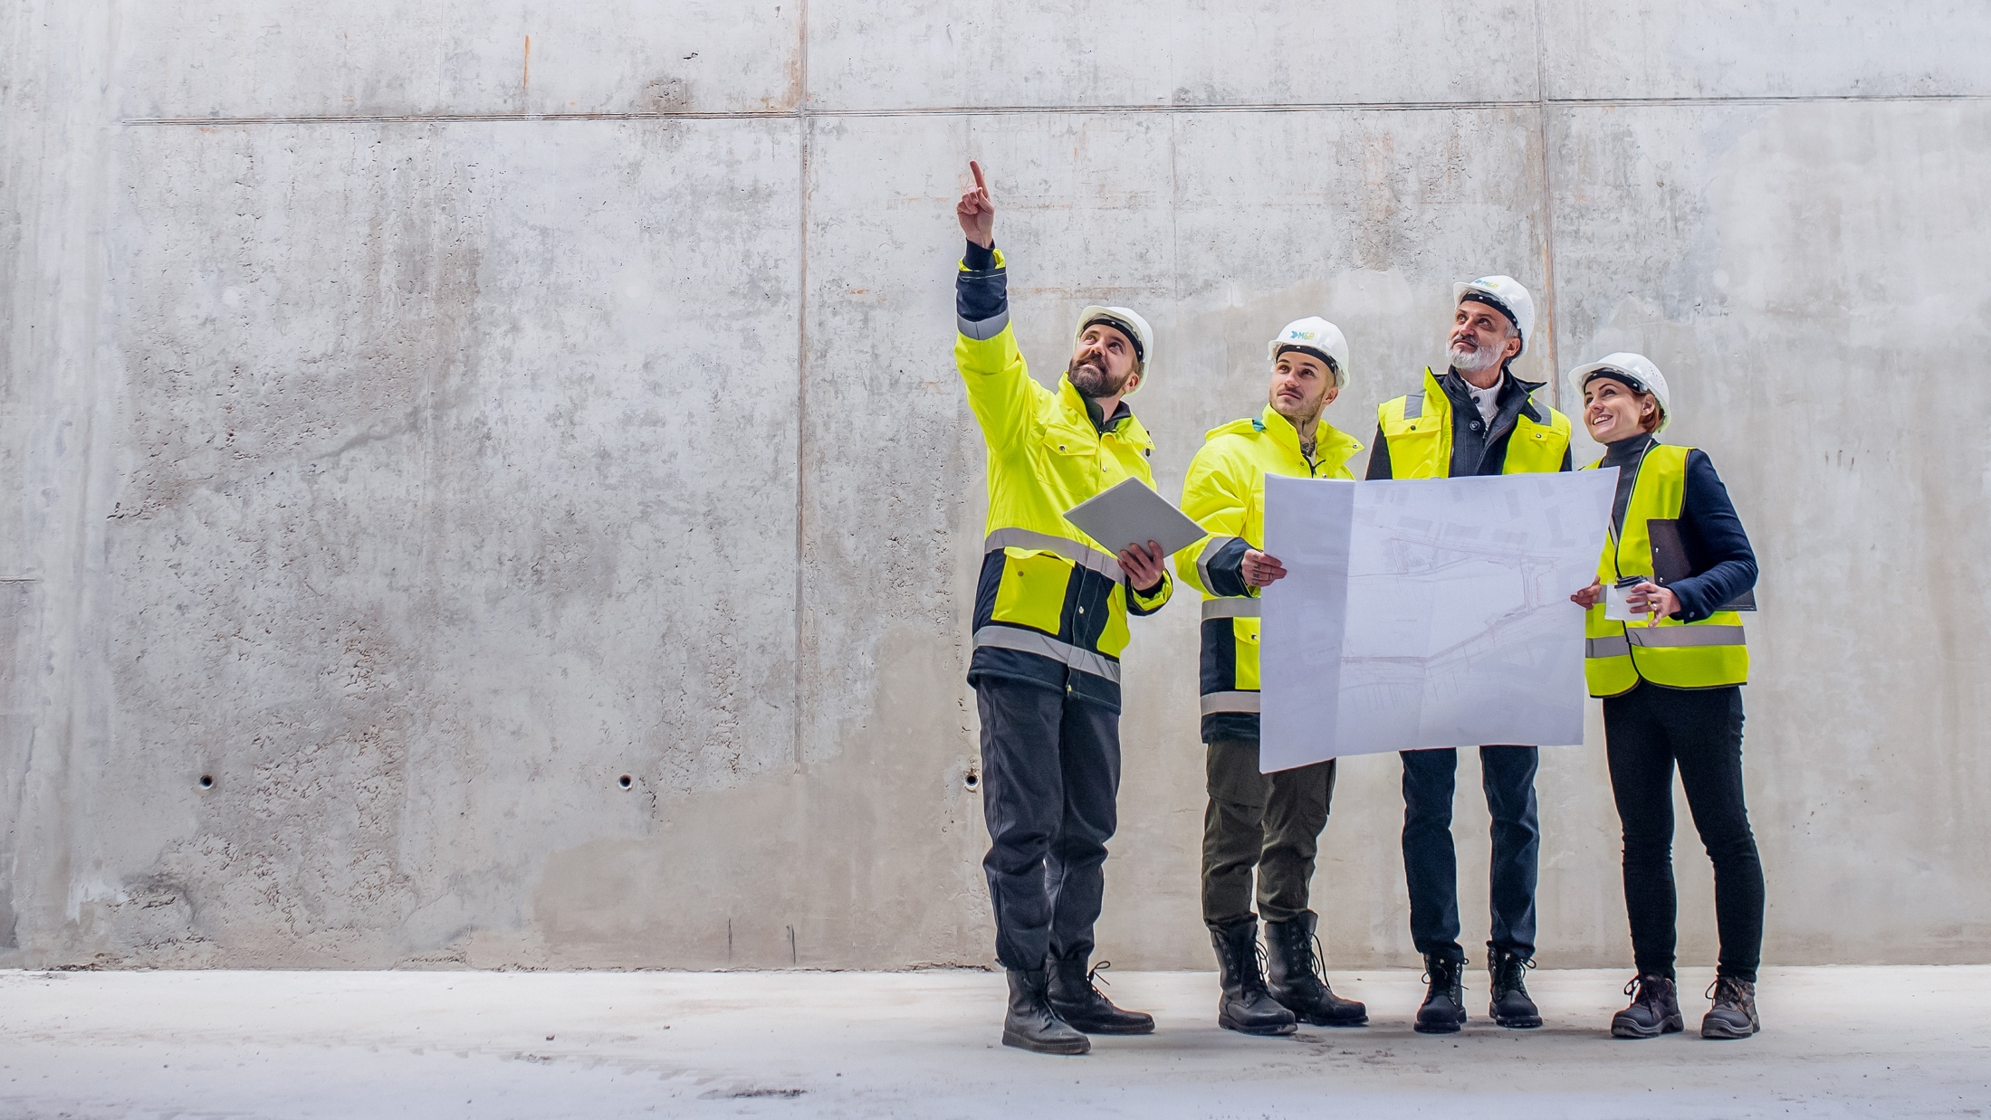
Innovativ -
Digital -
Sustainable
Introducing the M&P Group
Modern buildings meet these criteria – the M&P Group explains how! With innovative engineering solutions for energy and building technology, with concepts for the digitisation of buildings and their operation, and with sustainable energy concepts.
Added value for your real estate!

Slide 3




Our approach
Integrated systems ensure the greatest possible advantages for modern buildings. M&P develops interdisciplinary concepts and sustainable solutions.
The only way to achieve the highest levels of added value is to take a holistic view of a building and all its potential over its entire life cycle. Optimal technical, digital and organisational networking is our aim in every project.
In this context, we at M&P see ourselves as drivers of innovation for our clients, developing viable ideas and integrated concepts in important fields of innovation. This results in future-proof solutions for the construction and operation of your real estate.
Our experts work together in a cross-disciplinary manner to achieve this:
Engineers from all the energy and building technology trades develop innovative system solutions for building technology and building digitisation
Energy experts ensure the highest level of sustainability
Modern IT solutions digitise building operation
Consulting based on added value opens up potential for efficiency

Slide 4
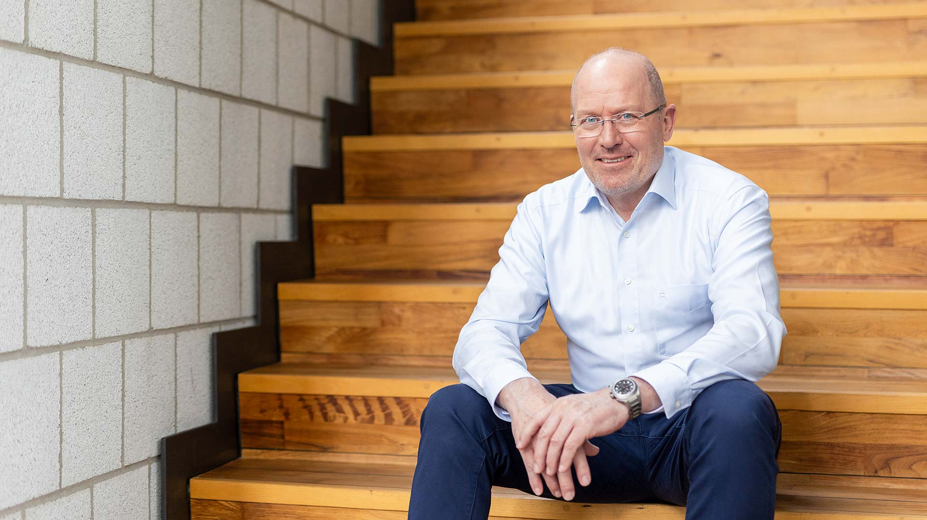
Introducing the M&P Group
‘We are guided by the conviction that an optimal technical, digital and organisational solution provides the greatest added value for a sustainable real estate!’
Olf Clausen, CEO M&P Group

Slide 5
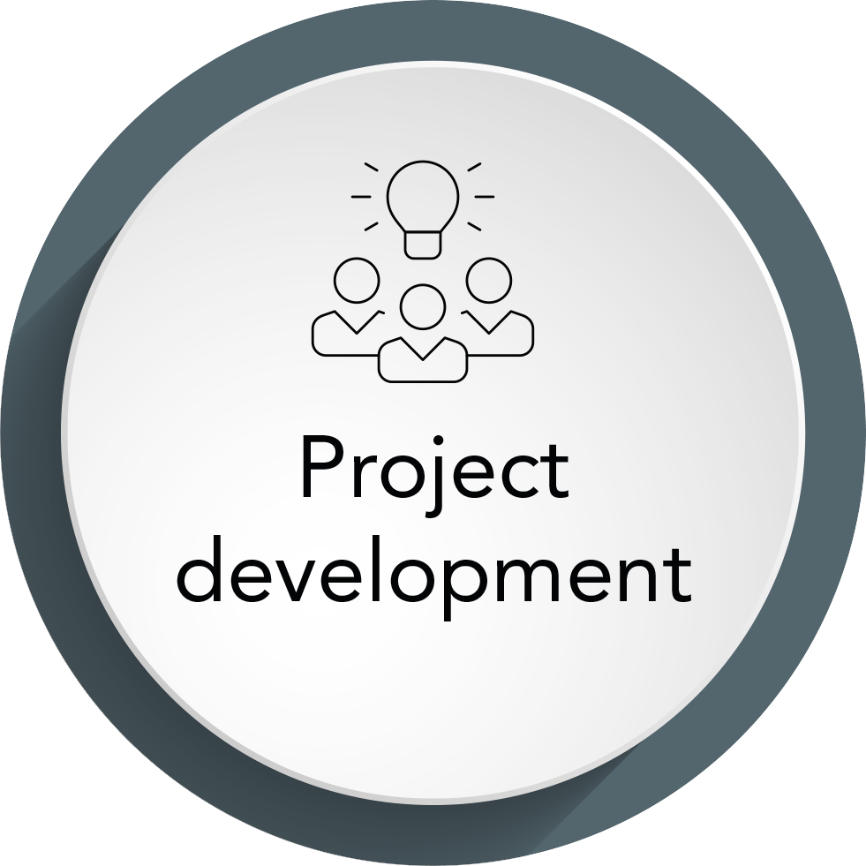
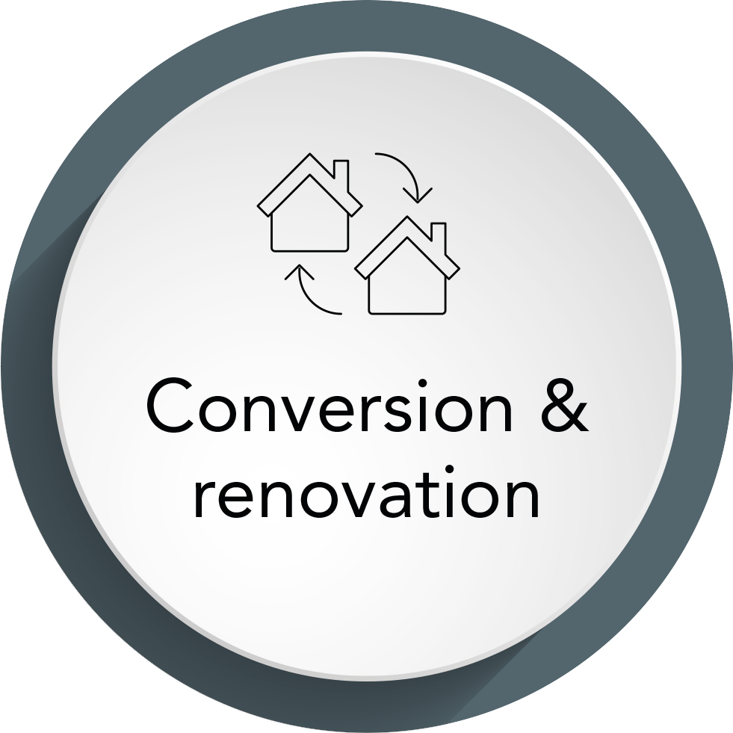

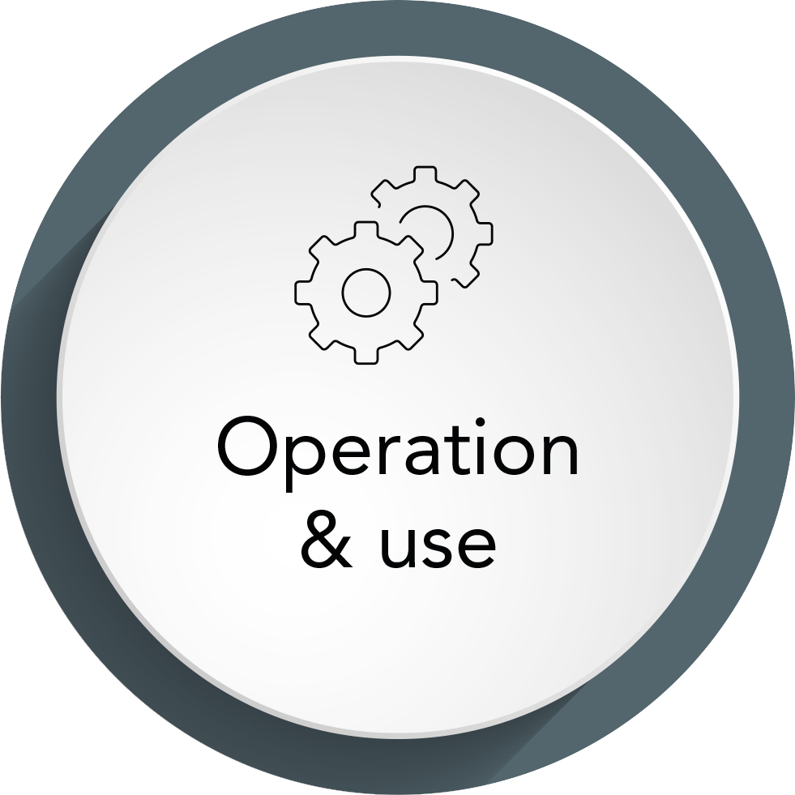

Our holistic solution expertise throughout the entire life cycle of a building makes us the people to get in touch with when it comes to real estate. Our clients include building owners, project developers and asset managers, engineers and architects, general contractors and facility service providers.
More than three decades of successful work provide evidence of our high levels of performance and underline our position as a driver of innovation. We know the industry like the back of our hand. We know its requirements and challenges. Our industry-specific knowledge and holistic consulting create space for change and progress. In every phase of the life of a property. We know what we are doing. And what needs to be done to plan, set up and operate buildings in a future-proof manner.
Get on board with us and benefit from our expertise.

Slide 6

Facts & figures 2024
Introducing the M&P Group
14
Offices
With 14 locations, we are represented throughout the entire German-speaking region - always in close proximity to our clients and their projects. Our innovative engineering solutions for energy and building technology, our pioneering ideas for the digitalisation of buildings and their operation and our sustainable energy concepts are just as seamless as our presence.
75,7
Million Euro
order backlog EOY
The overall order backlog at the beginning of the financial year 2024.
330
73,5
Million Euro
output
Employees
In 2023, gross operating revenue of € 73.5 million was achieved.
in the business fields of engineering, energy, IT solutions
and Consulting ensure the success of our customers in interdisciplinary, agile and networked structures.

Slide 7
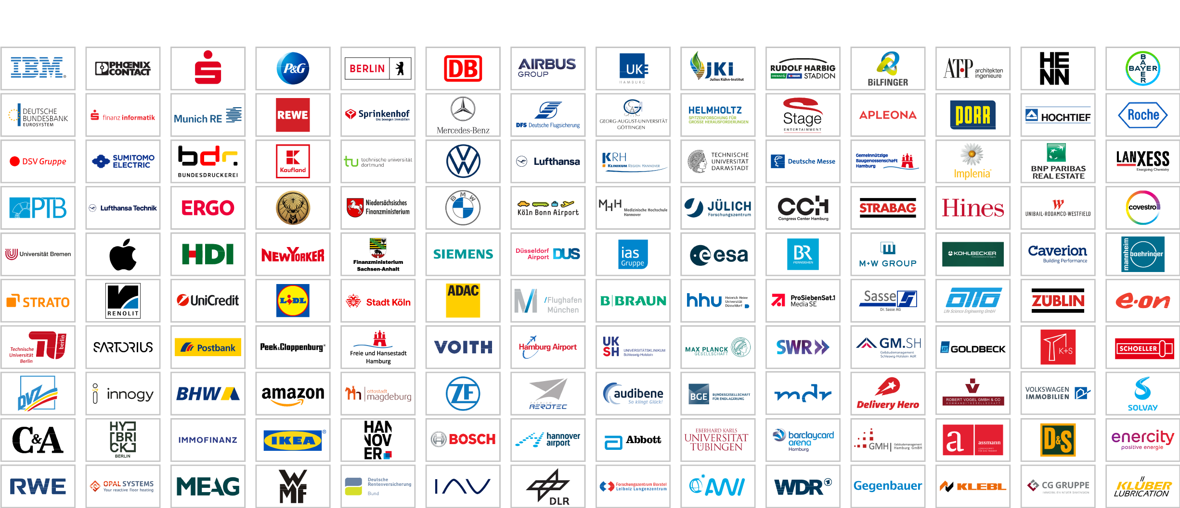
References
Data center
Technology
Finance
Consumer
goods & retail
Public
Automotive
Aeronautics
/aerospace
Health Care
Research
Media & entertainment
Professional services
Real estate
Real estate
Industry

Slide 8


History
How we became who we are.
Introducing the M&P Group
2018
Founding of
M&P Magdeburg
and M&P Essen.
2019
Founding of the technical office of ‘m+p Schweiz AG’ in Basel.
2023
Establishment of a branch office of M&P Dresden in Leipzig.
2024
Founding of the technical office of M&P Braunschweig in Paderborn.
2019
Acquisition of Lessor.
2016
Opening of subsidiaries
in Dresden and Frankfurt.
2018
Joint Venture ‘TGA 360°’
with IB Hornig to expand the
general planning competence.
2019
Sale of the ‘haveldata’
in Brandenburg.
2022
Acquisition of Schuster and Walther Software.
2023
Founding of
‘M&P Dresden’.
2023
Sale of the
M&P Solutions.
2025
2014
Founding of m+p
consulting in Stuttgart.
2009
Founding of m+p consulting Hanse in Hamburg and m+p consulting Rhein-Neckar in Mannheim as well as the m+p academy.
2014
Founding of m+p Schweiz in Wallisellen.
2011
Joint venture Savemaxx
Contracting with Apleona for
energy efficiency projects.
2006
Founding of m+p consulting West in Düsseldorf.
1999
Founding of the IT company m+p business solutions.
1993
Opening of the first
branch – m+p consulting Süd – in Munich.
2014
Opening of subsidiary
Berlin Stahnsdorf.
2012
Participation in BEGIS in Düsseldorf.
2010
Acquisition of haveldata
in Brandenburg.
2007
Participation of
ACS Consulting in Leipzig.
2003
Founding of Savemaxx in
Osnabrück (Melle).
1996
Participation of Apleona
(formerly Philip Holzmann AG,
later Bilfinger Berger HSG FM) in the M&P Group.
1989
Founding of an engineering
company by Prof. Dr. Kurt Müller and Olf Clausen on 05.05.1989.

Slide 9

Our service areas
Introducing the M&P Group
The M&P Group is divided into the service areas of Engineering, with expertise in all energy and building technology trades as well as building digitisation, Energy, with extensive expertise in energy efficiency, sustainability and decarbonisation, IT solutions for the digitisation of building operations based on SAP, and Consulting, focused on real estate management and facility management.

Slide 10

Using digital expertise to create innovative infrastructures
Introducing the M&P Group
ENGINEERING
Whether it is a new construction or renovation, energy optimisation or a large-scale international project: the engineers from M&P offer a full range of services as technical general planners in all HOAI work phases. Our solution-based expertise comes from a single source and is future-oriented. The buildings of tomorrow will be based on smart further development, and M&P is state of the art in the real estate and construction industry: we support construction projects from the start of the project through to the operating phase with comprehensive technical expertise, the latest IT tools and BIM-based (building information modelling) planning methods. Our digitised planning expertise takes process efficiency to the next level in every phase of a project and makes progress immediately visible. Taking life cycle engineering into a new dimension.
BSE general planning
Special engineering and prototyping
BIM and digital planning
Building digitisation
Lean project management
Cybersecurity
Master planning
Quality assurance
Green-Building-Design
Commisioning and simulation
System engineering

Slide 11

Bringing energy and efficiency into harmony
Introducing the M&P Group
ENERGY
Transforming the energy sector is the key to a carbon-neutral future. In addition to the energy sector itself, the buildings and industrial sectors are major protagonists in the energy transition. The ongoing high consumption levels bring enormous potential for energy efficiency, which M&P fully exploits – over the entire life cycle of a building or across production processes. From data-driven potential analysis to tailored optimisation concepts and energy efficiency partnerships: we provide you with effective support in implementing your sustainability strategy and on the path to climate neutrality!
Transformation concepts
Performance engineering
ESG
360° potential check
Energy audits
Commissioning management
Energy supply
Energy management
Implementation support
GEG inspections
Funding
District solutions

Slide 12

Lead digital transformation
Introducing the M&P Group
IT SOLUTIONS
The digital transformation is in full swing. It is changing infrastructures, working models and business processes. M&P is a key digitisation partner in the construction and real estate industry. With the expertise of an industry leader, we develop the roadmap for digital transformation in your company – with tailored solutions for your facility and real estate management. No matter what your company’s individual needs are, we connect you to the future.
BIM@FM
Ticket system
Service provider portal
Service management
FM for real estate
Smart maintenance 4.0
Construction cost controlling
Data model

Slide 13

Providing holistic consulting to create scope for action
Introducing the M&P Group
CONSULTING
Modern real estate and facility management combines infrastructure, people, technologies and know-how to create new scope for action – from planning to the operational phase. At M&P, the success of every transformation is a team effort: we network ideas from the fields of management consulting, engineering, energy and digitisation to provide pioneering solution-based expertise. Our systemic approach to optimisation brings holistic results: the best possible performance in every phase of your property’s life.
Business models
Project management
Organisational consulting
Commissioning management
Save-to-Perform
Digitisation consulting
Operating concepts
BIM consulting
FM tenders
Smart building consulting
Risk prevention
Technical-Due-Diligence

Slide 14












BSE general planning
Comprehensive planning expertise from a single source.
Sanitary engineering
Heating supply
Ventilation technology
Cooling supply
Holistic, efficient, pioneering: for more than 30 years, M&P has been acting as BSE general planner for all trades in cost group 400–480 in the construction and real estate industry.
With unparalleled solution expertise and a comprehensive service portfolio, we develop future-proof concepts that are precisely tailored to the needs of your technical systems.
Model-based planning methods such as BIM modelling and applied Lean construction management ensure systematic process optimisation and cost-optimised high-quality implementation in all HOAI phases:
Electrical engineering
Information and
telecommunications
technology
Conveyor technology
Kitchen appliances
Fire protection
technology
Building automation
and digitisation
System integration
and commissioning
Dynamic simulation
BIM design method + Lean project management method

Slide 15










Thank you
Memberships

Slide 16
Charts memory!
Further charts for individual structure

Slide 17

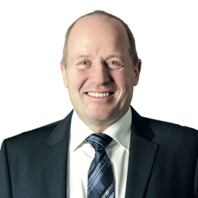
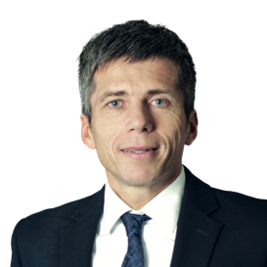
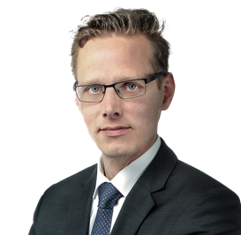
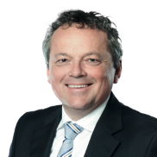
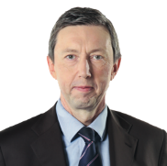
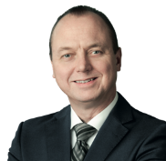
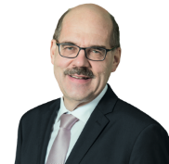
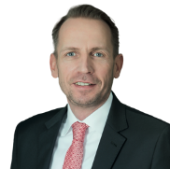
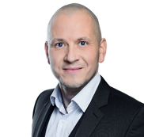
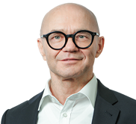
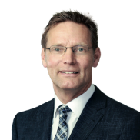
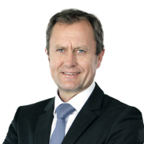
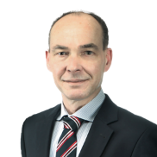
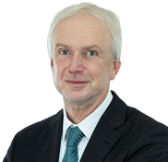
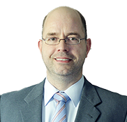
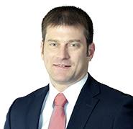
The M&P management
Introducing the M&P Group
Olf Clausen
Director
Company spokesman
Andreas Germer
Director
Sven-Eric Korff
Director
Ronald Meka
Director
Peter Schubert
Director
Andreas Götze
Director
Frank Urban
Director
Martin Niewiera
Director
Enrico Baude
Director
Uwe Dorn
Director
Andreas Fuhrmann
Authorised officer
Andreas Nikutowski
Authorised officer
Jörg Kegel
Authorised officer
Michael Golz
Authorised officer
Christoph Bergfeld
Authorised officer
Michael Maschkowitz
Authorised officer

Slide 18
Customer wall without branches

Slide 20
Charts with text content in the note field for personal presentation

Slide 21
Introducing the M&P Group
ENGINEERING
Using digital expertise
to create innovative infrastructures
We plan systems for energy and building technology according to the latest standards and create innovative technical solutions with the highest standards in terms of functionality, safety and sustainability.
BSE general planning
Special engineering and prototyping
BIM and digital planning
Building digitisation
Lean project management
Cybersecurity
Master planning
Quality assurance
Green-Building-Design
Commisioning and simulation
System engineering
Notes:
Whether it is a new construction or a refurbishment, energy optimisation or a large-scale international project: the engineers from M&P offer a complete range of services as general technical planners in all service phases of the German regulation on the fees for services rendered by architects and engineers (HOAI). Our solution expertise comes from a single source and is geared towards the future. Tomorrow’s buildings are based on smart development. In the real estate and construction industry, M&P is state of the art: we accompany construction projects from the start of the project to the operational phase with comprehensive technical know-how, the latest IT tools and model-based planning methods based on BIM (building information modelling). Our digitised planning expertise takes process efficiency to the next level in each stage of the project and makes progress immediately visible. A new dimension in life cycle engineering – for all trades in cost group 400.

Slide 22
Bringing energy and efficiency into harmony
Introducing the M&P Group
ENERGY
We develop solutions to provide efficient energy supply to real estate and have a positive impact in terms of resource conservation and CO₂ reduction.
Transformation concepts
Performance engineering
ESG
360° potential check
Energy audits
Commissioning management
Energy supply
Energy management
Implementation support
GEG inspections
Funding
District solutions
Notes:
The transformation of the energy industry is the key to a CO₂-neutral future. The construction and real estate industry is becoming an important player in the energy transition: buildings are still responsible for one third of global greenhouse gas emissions. The high consumption rates create enormous potential for energy efficiency, which M&P makes full use of – over the entire life cycle of a building: from cloud-based potential analysis to tailor-made optimisation concepts and energy-efficiency partnerships: we effectively support you in the implementation of your sustainability strategy!

Slide 23
Lead digital transformation
Introducing the M&P Group
IT SOLUTIONS
We design IT solutions for the construction and operation of real estate in the belief that digitisation creates added value.
BIM@FM
Ticket system
Service provider portal
Service management
FM for real estate
Smart maintenance 4.0
Construction cost controlling
Data model
Notes:
Digital transformation is in full swing. It is changing infrastructures, working models and business processes. M&P is the leading digitisation partner in the construction and real estate industry. With the expertise of an industry leader, we develop the roadmap for digital transformation in your company – with ERP, project service and field service solutions. No matter which industry you work in and what specific needs you have: we connect you with the future. On the basis of Microsoft 365 and SAP.

Slide 24
Providing holistic consulting to create scope for action
Introducing the M&P Group
CONSULTING
We see consulting as the expertise to shape changes and create future-oriented solutions for the construction and real estate industry.
Business models
Project management
Organisational consulting
Commissioning management
Save-to-Perform
Digitisation consulting
Operating concepts
BIM consulting
FM tenders
Smart building consulting
Risk prevention
Technical-Due-Diligence
Notes:
Modern real estate and facility management combine infrastructures, people, technologies and know-how to create new scope for action – from planning to the operational phase. The success of every transformation is a team effort at M&P: we network ideas from the areas of management consulting, engineering, energy and digitisation to create groundbreaking solution competence. Our optimisation approach is systematic, our results are holistic: top performance in every stage of the life of your property.

Slide 25
TGA general planning
Comprehensive planning expertise from a single source.
Sanitary engineering
Heating supply
Ventilation technology
Cooling supply
Electrical engineering
Information and
telecommunications
technology
Conveyor technology
Kitchen appliances
Fire protection
technology
Building automation
and digitisation
System integration
and commissioning
Dynamic simulation
BIM design method + Lean project management method
Notes:
Holistic, efficient, pioneering: for more than 30 years, M&P has been acting as TGA general planner for all trades in cost group 400–480 in the construction and real estate industry. With unparalleled solution expertise and a comprehensive service portfolio, we develop future-proof concepts that are precisely tailored to the needs of your technical systems. Model-based planning methods such as BIM modelling and applied Lean construction management ensure systematic process optimisation and cost-optimised high-quality implementation in all HOAI phases:

Slide 26
Chapter slide as a topic separator

