Slide 1
PROJECTS, SOLUTIONS, PARTNERSHIPS.
The M&P Group introduces itself.
01/2021

Slide 2
THE M&P GROUP.
Since it was founded in 1989, the M&P Group has evolved from a regional engineering office into a European-wide consulting and service company.
Today, we are one of the most innovative technical corporate consulting firms
in the German-speaking realm.
We’ll show you why.

Slide 3

OUR MISSION.
Our mission, our assignment is to set the legal targets while upholding our standards. We define the implementation of the M&P core brand “added value”
as “creating added value”.
Added value does not develop by itself. It requires creative input. And that is what we do: As experienced technology partners, we contribute to (ensuring) our clients’ future viability by substantially and sustainably improving their commercial, technical and infrastructural foundations.
Our added value-oriented consulting is characterised by advanced strategies, efficient processes, networked structures and low-risk optimisations.
Our thinking and actions are solution-oriented and geared towards our clients‘ business objectives.
We are thirsty for new challenges and encounter them openly, with curiosity and with unconventional ideas.
As a proprietary company, we collaborate as partners with clients and employees in a responsible, independent and reliable manner – with real passion.
This is our mission. This is what we are working on.
Each of us individually and as a team.

Slide 4


TIME TRAVEL
1989
Founding of an engineering
company by Prof. Dr. Kurt Müller
and Olf Clausen.
1999
Founding of the IT company
m+p business solutions.
2003
Founding of Savemaxx in
Osnabrück (Melle).
2011
Joint venture Savemaxx
Contracting with Apleona for
energy efficiency projects.
2012
Participation in BEGIS
in Düsseldorf.
2014
Opening of subsidiary
Berlin Stahnsdorf.
2018
Founding of
M&P Magdeburg
and M&P Essen.
2019
Acquisition of
Lessor GmbH.
2009
Founding of m+p consulting Hanse
in Hamburg and m+p consulting
Rhein-Neckar in Mannheim as well
as the m+p academy.
1990
1995
2000
2005
2010
2015
2019
2020
1993
Opening of the first branch –
m+p consulting Süd – in Munich.
2006
Founding of m+p consulting
West in Düsseldorf.
2007
Participation of
ACS Consulting
in Leipzig.
2010
Acquisition of haveldata
in Brandenburg.
2014
Founding of m+p consulting
Stuttgart and m+p Schweiz in
Wallisellen (CH).
2016
Opening of subsidiaries
in Dresden and
Frankfurt.
2018
Joint Venture „TGA 360° GmbH“
with IB Hornig to expand the
general planning competence..
2018
Sale of the haveldata
in Brandenburg
2019
Opening of
subsidiary
in Basel (CH).
1996
Participation of Apleona
(formerly Philip Holzmann AG,
later Bilfinger Berger HSG FM
GmbH) in the M&P Group.

Slide 5

SOME FACTS.
82
CROSS-SEGMENT
PROJECTS
PERCENT
332
EMPLOYES
15
LOCATIONS
1989
COMPANY FOUNDATION
64,3
BUSINESS PERFORMANCE
Mio. €
70
MILLIONS €
35
Status 12/2019
0
1989
2001
2012
2019

Slide 6
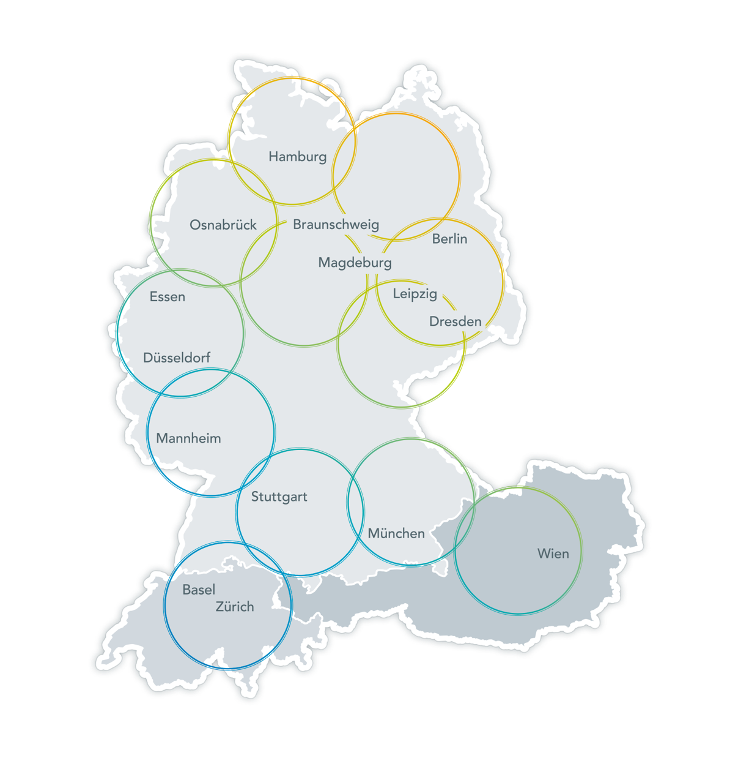
OUR LOCATIONS.
Locations are not irrelevant. Locations are important because proximity is important. Proximity can be achieved in a number of different ways. Physical proximity has the significant advantage that the paths are shortened, which certainly facilitates and probably intensifies exchange. Shorter pathways are a criterion
and a synonym for uncomplicated, collaborative work.
With 15 business sites in Germany, Austria and Switzerland, we cover German-speaking regions and are, therefore, usually relatively close to our clients and their projects. This is particularly true in the figurative sense. Our standpoint, our approach to our work and to the desired outcome is the same everywhere, no matter where we are located.

Slide 7

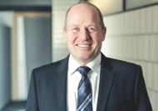
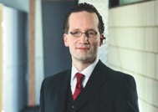
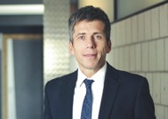
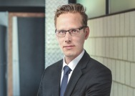
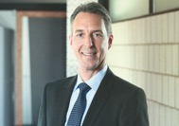
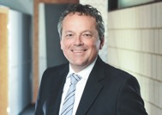
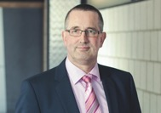
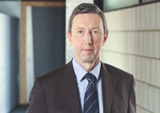
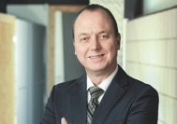
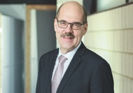
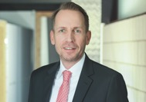
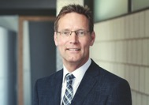
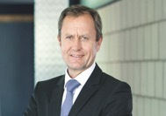
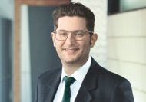
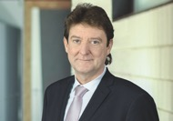
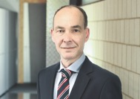
OUR MANAGEMENT.
OLF CLAUSEN
CEO
ANDREAS GERHARDY
Director
ANDREAS GERMER
Director
SVEN-ERIC KORFF
Director
THOMAS LINDNER
Director
RONALD MEKA
Director
RAINER HELMBOLDT
Director
PETER SCHUBERT
Director
ANDREAS GÖTZE
Director
FRANK URBAN
Director
MARTIN NIEWIERA
Director
ANDREAS FUHRMANN
Authorised officer
ANDREAS NIKUTOWSKI
Authorised officer
SERGIO CAMPISI
Authorised officer
UDO HERTEL
Authorised officer
JÖRG KEGEL
Authorised officer

Slide 8

In our work, we are guided by the realisation that an optimum technical, digital and organisational basis constitutes the greatest added value for the client business.
Added value, which we generate for our clients through a groundbreaking consulting approach. We combine highly qualified expertise in the fields of consulting, engineering, energy and IT solutions with unique project-specific
problem-solving skills. This ensures the greatest benefit for the client.
In flexible, interlinked structures, we develop innovations and optimal technical solutions to support production and the core business. Our solution-oriented pledge comprises both specialist expertise, the client’s strategic requirements and the associated interdisciplinary project work in our corporate group’s network of competence.

Slide 9
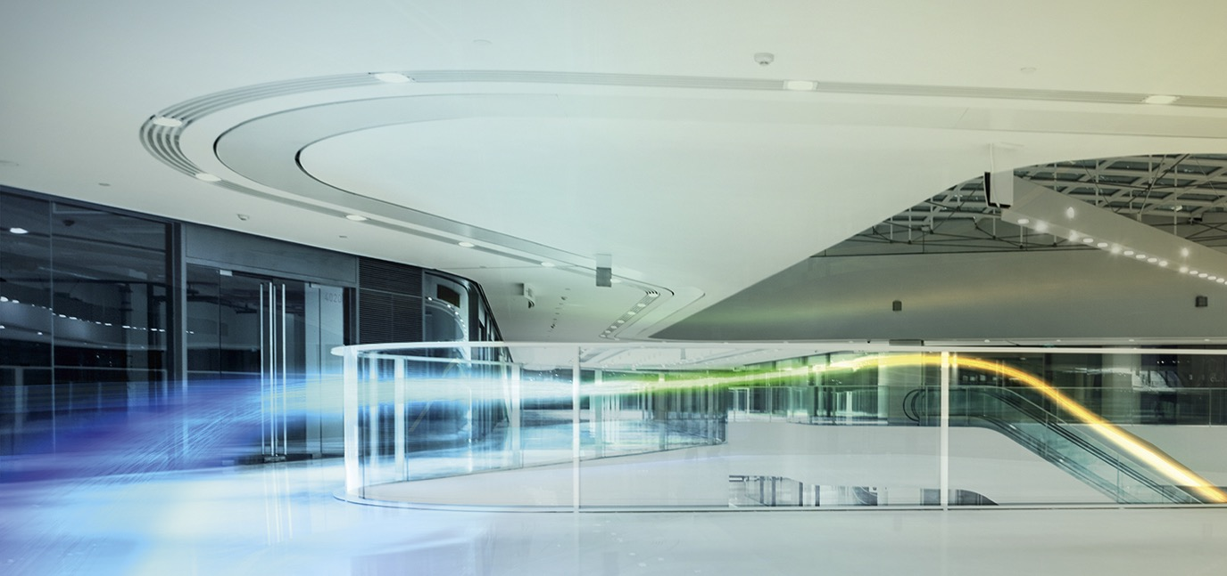
OUR DIVISIONS.
ENGINEERING
Whether it is a new building or a refurbishment project,
energy optimisation or a major international project: As one
of the five largest engineering offices in Germany for building services engineering, we offer you planning competence that sets standards – for all trades of the cost group 400.
Master Planning
Green-Building-Design
System Engineering
System Engineering and Prototyping
Building Digitisation
TGA 360°
Quality Assurance
Commisioning & Simulation
Technical Due Diligence (TDD)
BIM & Digital planning

Slide 10
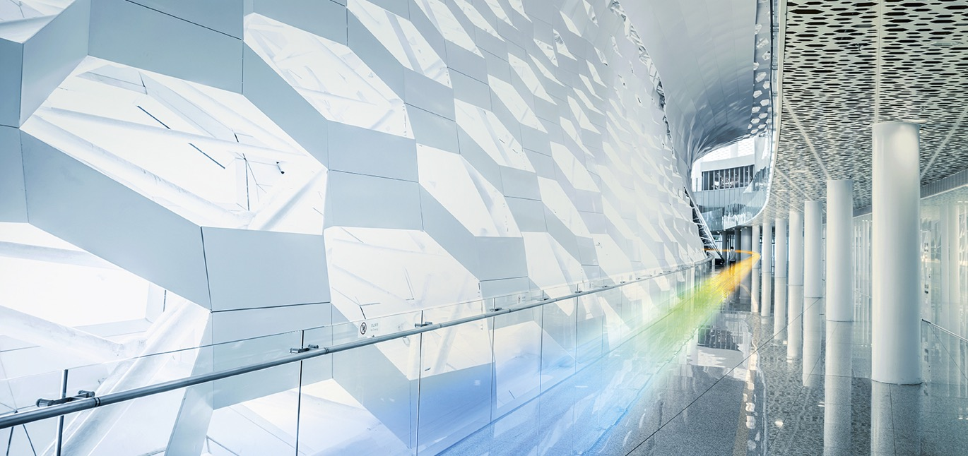
OUR DIVISIONS.
ENERGY
The energy transition presents a major challenge for companies. M&P supports you in all optimisation processes and ensures that you can afford to save on energy costs, too.
EnEV inspections
360° energy potential check
Energy audit
Performance engineering
Energy management
Energy contracting services
Efficiency partnership
Project development

Slide 11

OUR DIVISIONS.
IT SOLUTIONS
We offer highly efficient software solutions as the basis for your corporate success. Microsoft- and SAP-based.
Companysoftware based on Microsoft Dynamics
IT-Systems to control administration Prozess based on Microsoft Products
SAP-Systempartnership for Real Estate Management
and Facility Management

Slide 12

OUR DIVISIONS.
CONSULTING
Economic success is based on the ability to change. Anyone who seeks to move ahead, must think ahead too. When advising you, we therefore always keep an open mind – from providing solutions in facility management to developing business models tailored to your key requirements of the core business.
Business Models
Organisational Consulting
Save-to-Perform
Digital Real Estate
Operating Concepts
Sourcing
Quality Assurance
Project Management
BIM & Digitisation

Slide 13
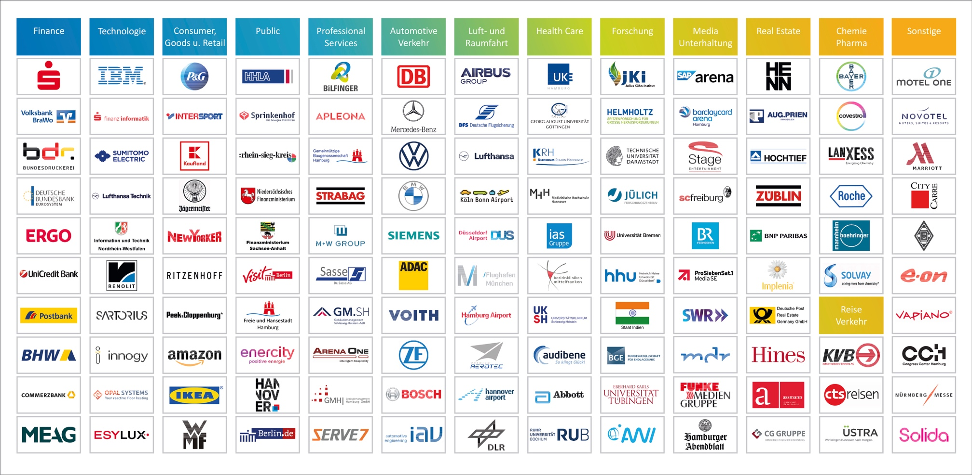
OUR REFERENCES.

Slide 14















THANK YOU FOR YOUR ATTENTION.
M&P Gruppe
Gablonzstraße 2-4
38114 Braunschweig
Office: +49 531 25602 0
Mail: info@mp-gruppe.de
Memberships

